Slide 1
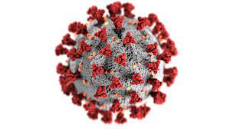


COVID – 19 Analysis
Presented By:
Piyush Tiwari, Sachin Panghal
Pooja Singh and Shivam Sharma

Slide 2
What is Corona-virus?
Coronaviruses are a type of virus. There are many different kinds, and some cause disease. A coronavirus identified in 2019, SARS-CoV-2, has caused a pandemic of respiratory illness, called COVID-19
The first case of COVID-19 was reported Dec. 1, 2019, and the cause was a then-new coronavirus later named SARS-CoV-2. SARS-CoV-2 may have originated in an animal and changed (mutated) so it could cause illness in humans.
Symptoms show up in people within two to 14 days of exposure to the virus. A person infected with the coronavirus is contagious to others for up to two days before symptoms appear, and they remain contagious to others for 10 to 20 days, depending upon their immune system and the severity of their illness.
A few symptoms of this virus are : Cough, Fever or chills, Shortness of breath, Reduction in the o2 levels, Sore throat and no taste or smell of any edibles.

Slide 3
Statistical Data and Analysis
The further slides contain the statistical analysis over the number of cases which were tested, confirmed, recovered, deceased, vaccinated 1 and vaccined2.

Slide 4
India’s Total Statistical Covid Virus Data
Below shown are stats which represent the total amount of cases in India relating towards :
Tested, Confirmed, Deceased, Recovered, Vaccinated 1 and Vaccinated 2

Slide 5
Category-wise analysis regarding testing ratio
According to the Categories given, we can analyze that there were only 5 districts which has the testing ratio more than 0.50. Testing ratio = Total tests / total population. [District wise]
The above analysis made us curious to check the deaths in the same categories. So we got to know that – where testing ration was less the number of deaths were high as shown in the chart below.

Slide 6
Comparing confirmed cases data of last 7 days (delta7) with vaccinations(1 & 2)
As we compared the last 7 days data (delta7) regarding confirmed, vaccinated 1 and vaccinated 2 cases, we noticed that even though the confirmed were massively high in Kerela they weren't even in the TOP 5 states for vaccinations.
West Bengal adapted faster than any other state and as soon as the confirmed cases went even a little high the number of vaccinated 1 and vaccinated 2 rose very high

Slide 7
Months where India had the most Confirmed and Recovered cases
In the Year 2021, the month which has the highest confirmed and recovered cases was May whereas for the Year 2020, it was September.

Slide 8
Week where Confirmed and Deceased cases were highest in India.
In the Year 2021, 2nd Week of May had the Highest Confirmed cases and whereas in the Year 2020, it was for the 3rd week of September
In the Year 2021, 4th Week of May had the Highest Deaths cases and whereas in the Year 2020, it was for the 3rd week of September

Slide 9
Comparing Top District data regarding Confirmed and Deceased cases
By Comparing total confirmed and confirmed cases per lakh, we found out that the confirmed cases number was higher in Bengaluru Urban, Karnataka but the confirmed cases per lakh were much more in Aizawl, Mizoram.
By Comparing total deaths and deaths cases per lakh, we found out that the deceased cases number was higher in Pune, Maharashtra but the deceased cases per lakh were much more in Satara, Maharashta.

Slide 10
States where Confirmed and Deceased cases were highest in India.
By Comparing total confirmed and confirmed cases per lakh, we found out that the confirmed cases number was higher in Maharashtra but the confirmed cases per lakh were much more in Lakshadweep
By Comparing total deaths and deaths cases per lakh, we found out that the deceased cases number was higher in Maharashtra but the deceased cases per lakh were much more in Goa

Slide 11
Challenges Faced And Learnings:
Challenge: Converting the .Json file to .CSV was the biggest worry.
Learning: Google was a big help and also senior guidance was of great use due to which we got to learn new libraries such as Json and requests and coding using loc solving massively nested files.
Challenge: A parameter was needed for conversion as the numerical values such as confirmed, tested, and deceased cases were too high where the population was high and too low where the population was low.
Learning: For this, we considered a parameter such as (per million) or (per lakh) which helped us overcome the higher and lower population factor.

Slide 12
Challenges Faced And Learnings:
Challenge: One of our partners (Shivam Sharma) was not available after the initial 2 days of the project due to certain health issues due to which the work segregation became more difficult for the 3 of us.
Learning: We learned how to face such challenges and collaborate with the remaining team members and complete the project before or on time without getting stressed/pressurized.
Challenge: We were facing problems in collaboration and in daily updates.
Learning: So, for this challenge one of my team members has created a notion doc and uploaded everything on notion whatever is needed for the project. We were also giving a daily update on it. And we learned a new official skill as to how to use Notion.

Slide 13
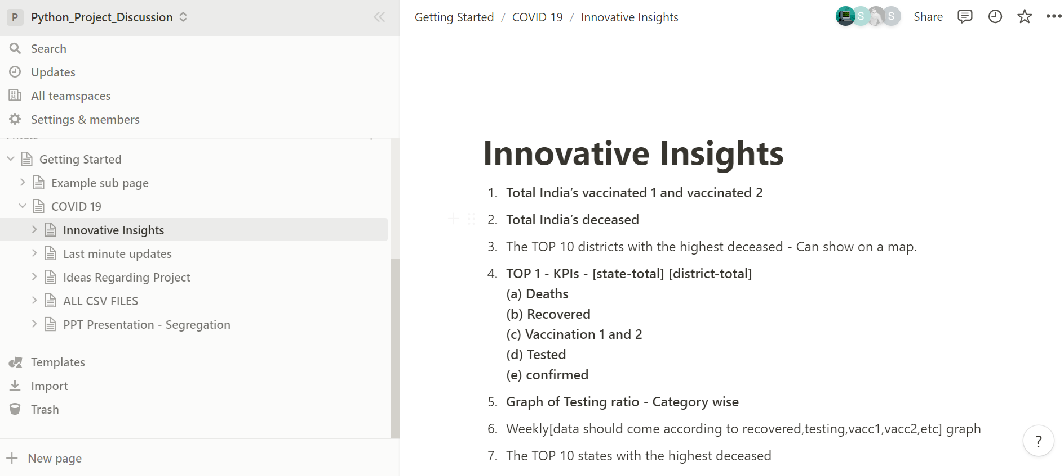
The Notion Page Image
Above is the image of the notion page that we collaboratively worked on.

Slide 14
THANK YOU !

